Slide 1
Baroque Era
1600-1750

Slide 2
Baroque Era
Baroque is a term generally used by music historians to describe a broad range of musical styles in a large geographic area covering much of Europe and lasting for about 150 years between 1600-1750.
http://www.youtube.com/watch?v=LFBIJgkj_-g
Handel For Unto Us

Slide 3
Handel Telemann Pachelbel Bach Lully Couperin Rameau Purcell Vivaldi Corelli Scarlatti

Slide 4
Baroque music and architecture is known for its elaborate ornamentation
Carvings, decorations, ironwork
Gold filagree and carvings
on top of carvings

Slide 5
Baroque Music
Elaborate ornamentation
Rhythmic impulse or drive
Expanded size, range and complexity of instrumental performances
New instrumental playing techniques
Figured bass leads to a grounding of tonality
http://www.youtube.com/watch?v=Zpf38dQpMzk
Bach Brandenburg No 1

Slide 6
Pipe Organ The pipe organ was the main keyboard instrument of the Baroque period. Most churches had elaborate, large pipe organs that took up entire walls and had multiple keyboards including one for the feet. http://www.youtube.com/watch?v=F4JQZb83oCc Bach Toccata & Fugue

Slide 7
Johann Sebastian Bach Toccata and Fugue

Slide 8
The harpsichord - the other keyboard instrument of the Baroque Era. The strings were played with a plucking mechanism, so it has a jangling sound. http://www.youtube.com/watch?v=SA0viFTN1zU
Scarlatti

Slide 9
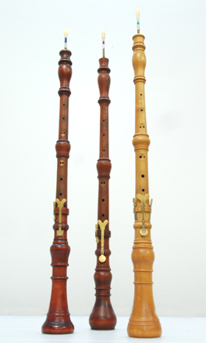
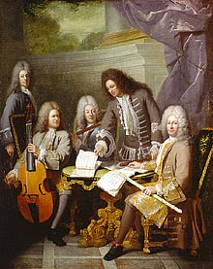
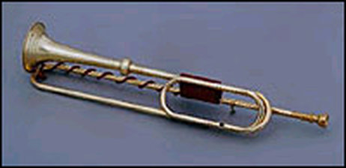
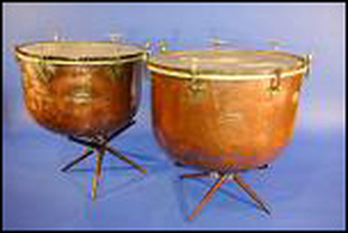
Instruments of the Baroque rise of concerto grosso http://www.youtube.com/watch?v=aFHPRi0ZeXE Vivaldi Spring Concerto

Slide 10
Improvement in instruments allowed for greater range, more complex playing techniques and larger orchestras
Concerto
Concerto Grosso
sonata
featured solo instrument with orchestra accompaniment
Soloist
Figured bass
keyboard

Slide 11
Vocal Music of the Baroque Era http://www.youtube.com/watch?v=C3TUWU_yg4s Handel Halleluia Chorus
Opera | Oratorio Mass | Cantata
soloists | soloists | 1 soloist
chorus | chorus
Orchestral accompaniment | Orchestral accompaniment | Keyboard Accompaniment & figured bass
Staged Performed in theater/opera house | Performed in church | Performed in salon or at a party
Costumes and sets | no | no

Slide 12
George Frederic Handel 1685-1759
Born in Germany but settled in London, England
Kapellmeister for Prince Georg
Composed for aristocracy at first but later composed for the people.
Best known works are
The Messiah (which includes the Halleluiah Chorus)
Water Music
Royal Fireworks Music
http://www.youtube.com/watch?v=TRNmXwNnB9w
http://www.youtube.com/watch?v=EDbzB9hjzPA
Handel Water Music

Slide 13
Johann SebastianBach http://www.youtube.com/watch?v=BnjqGhAlFzs
1685-1750
German
Lived in Leipzig and Weimar
During his lifetime he was best known as an organist.
Prolific composer (but not recognized until after his death)
Master of counterpoint
Some important works
Mass in B Minor
Well Tempered Clavier
Toccata and Fugue
Goldberg Variations
The Brandenburg Concertos

Slide 14
Antonio Vivaldi 1678 -1741 http://www.youtube.com/watch?v=bwe8ycrMX2w Alla Rustica
Widespread fame throughout Europe during his lifetime
The Red Priest
Virtuoso violinist
Catholic priest
Ospedale della Pieta (an orphanage for wayward girls)
Opera Imprasario
Prolific composer and famous throughout Europe
The Four Seasons
Concerto Grosso
expanded the range and playing possibilities of instruments

Slide 15
Pachelbel Canon http://www.youtube.com/watch?v=soIQ52hkMXw The Pachelbel Kanon is one of the most beloved pieces of the Baroque Era. It features an 8 bar bass line with a 3 part canon in the upper voices. A canon is a typed of composition that utilizes counterpoint similar to a round.

